Slide 1
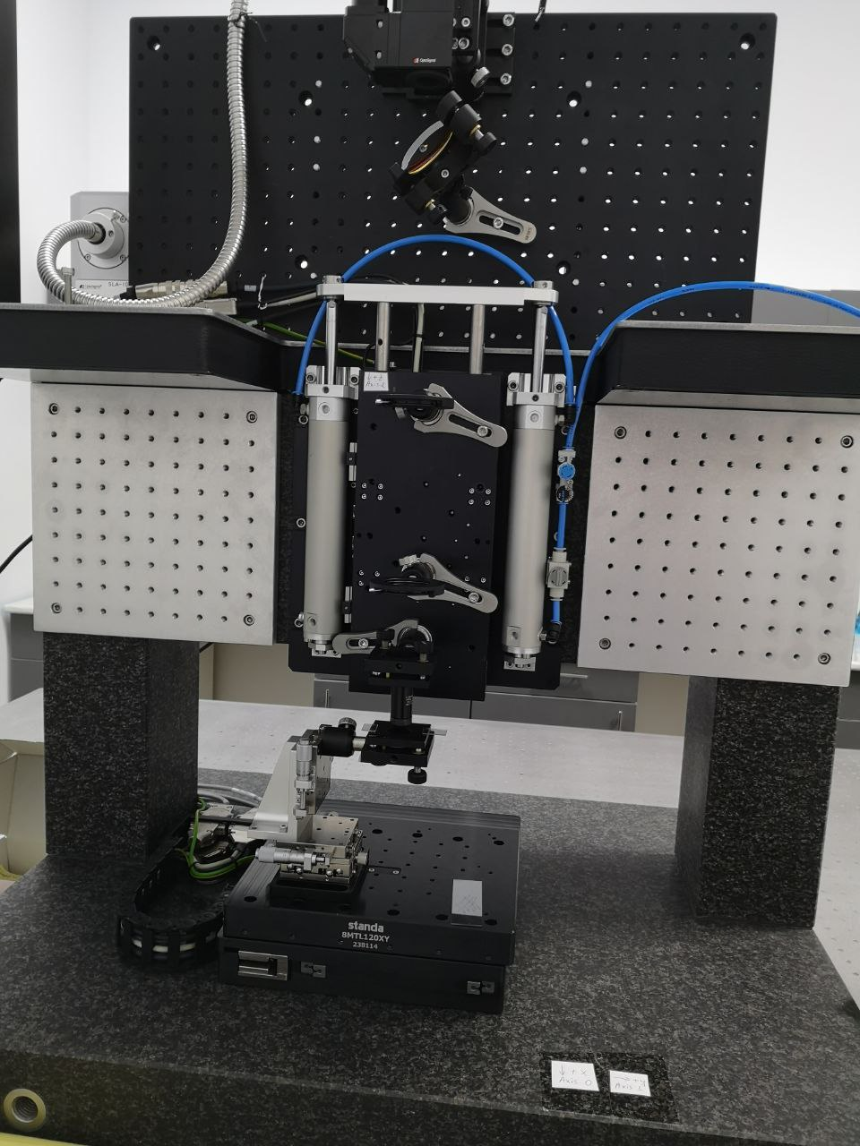
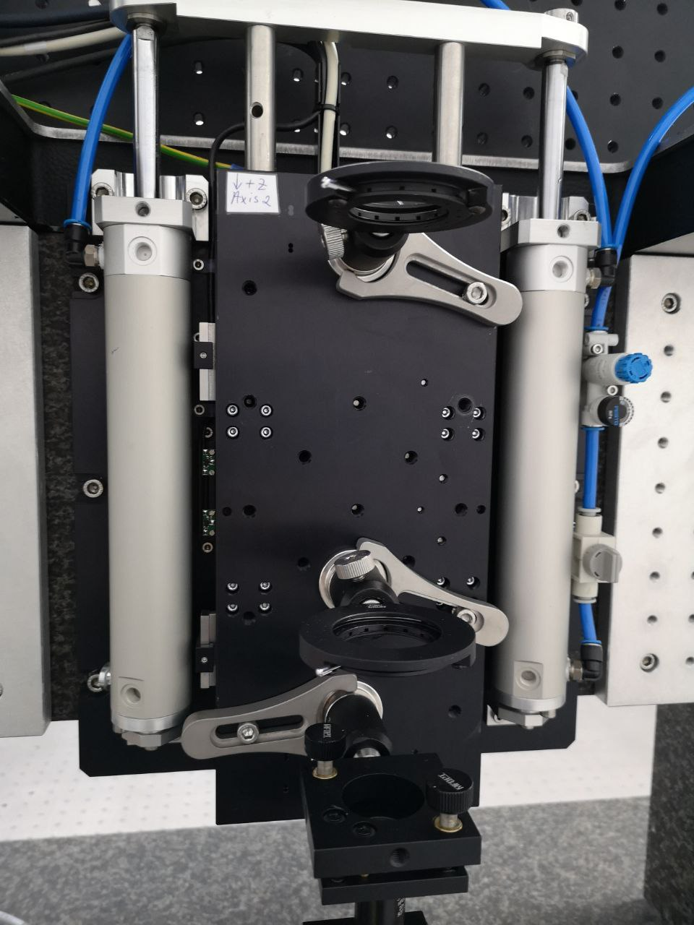
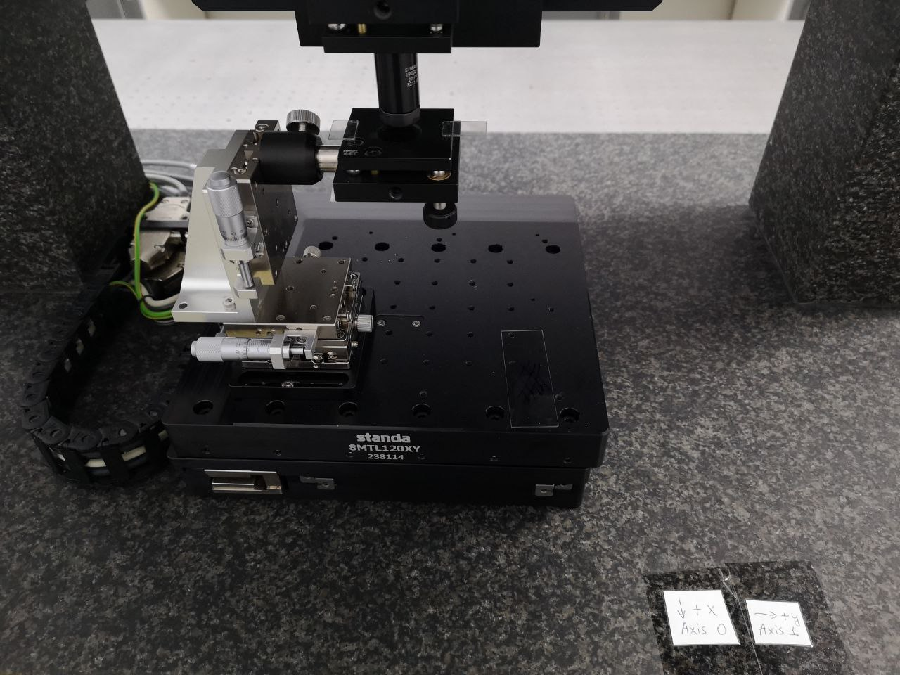
3D stage
Z coordinate
X,Y coordinates

Slide 2
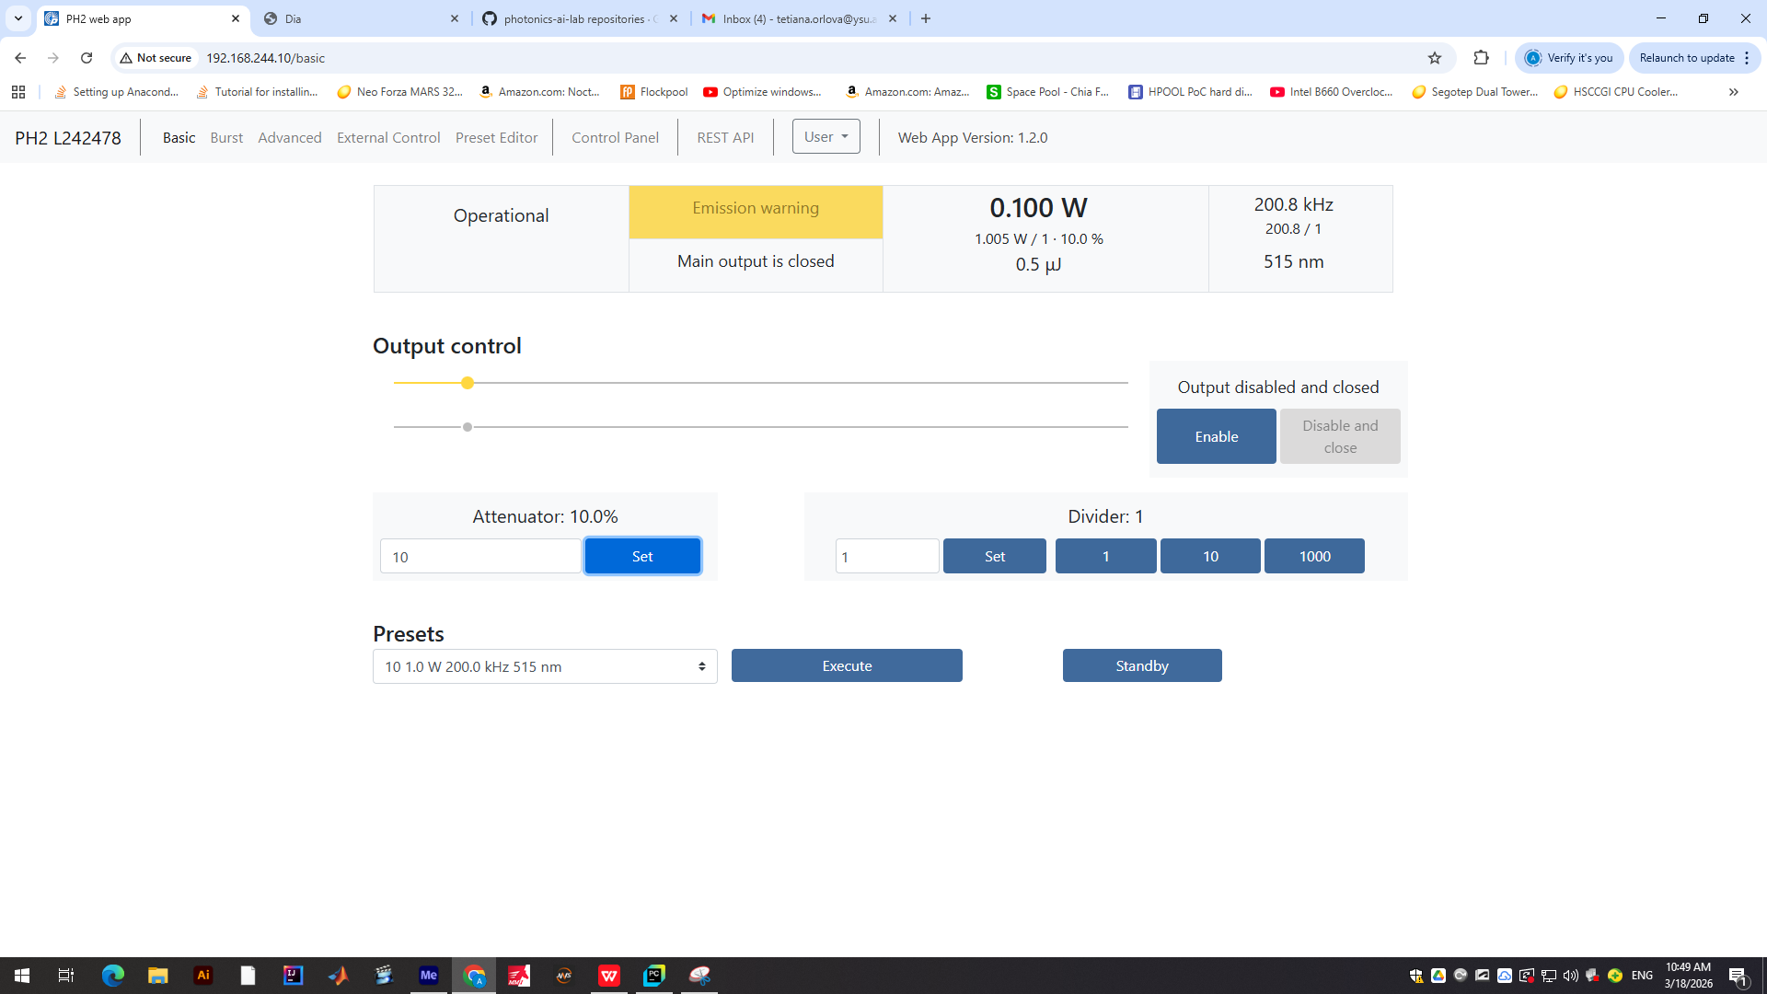
Laser control
Attenuator
(affects beam power)
Divider
(affects pulses)
Initial power, pulse frequency (repetition rate), and wavelength

Slide 3
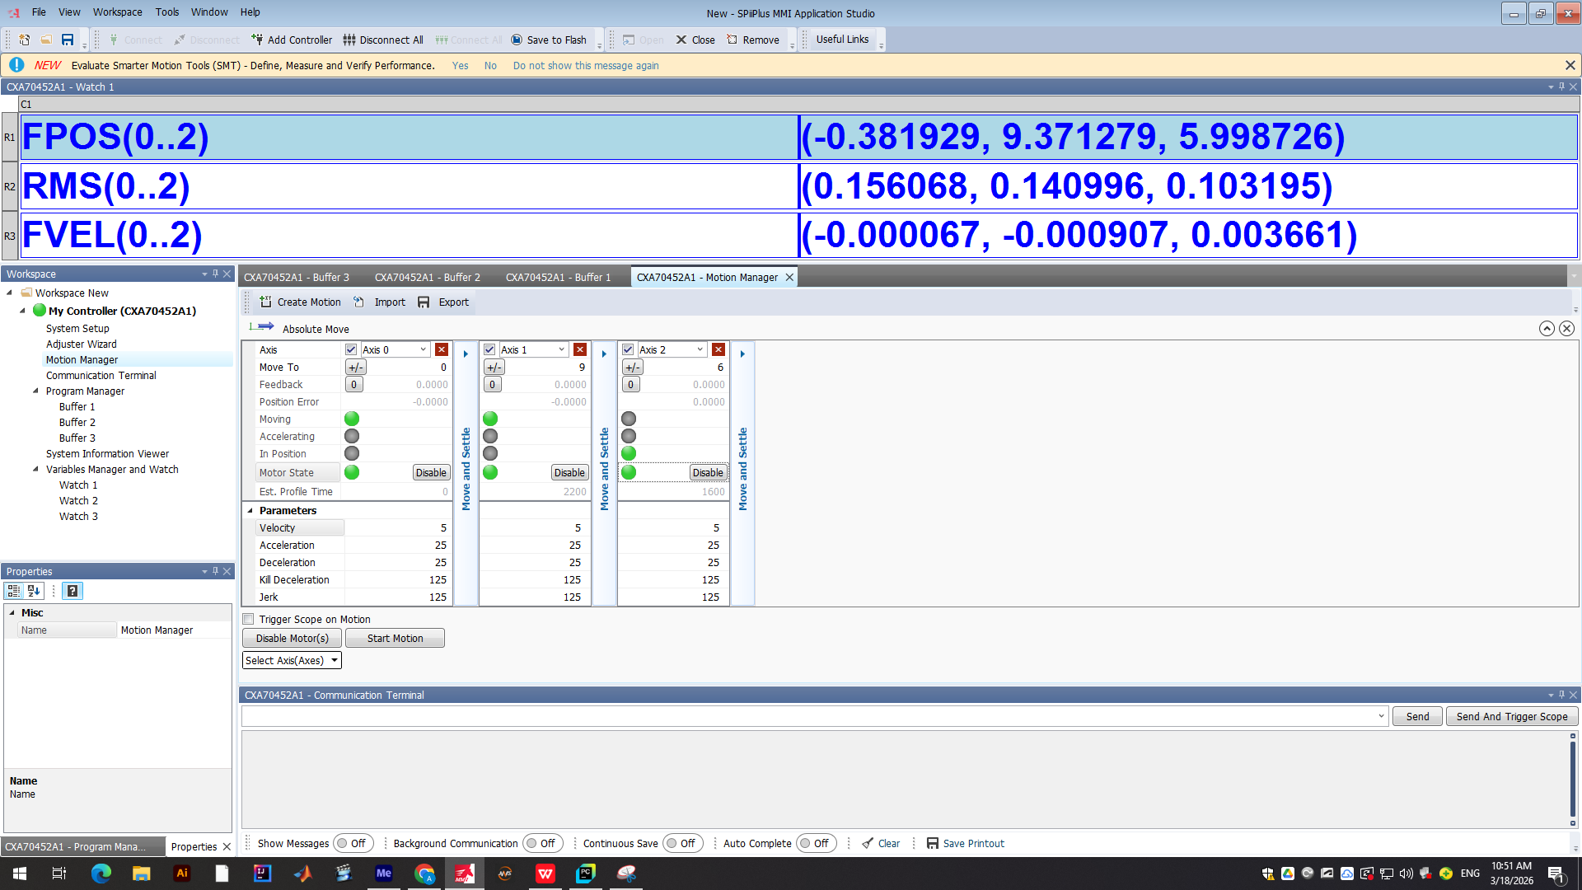
3D stage control
Position
Voltage
Velocity
Full range for each axis is from +25 mm to –25 mm.
Position control is down to 1 micron (at least).

Slide 4
To do Plan
Check codes controlling the laser and stage. Have all the settings been transferred to the Python? Are they all controllable?
Add comments and descriptions to all procedures. The main codes are: laser_control.py, lines_laser_states_from_cords.py
The well-written code (at least we believe in that) is parameter_optimization.py. It prints individual lines. However, we need to print now of a set of z-stacks, like in the code parameter_optimization_for_2pp.py.
Either to marriage them, or to rewrite based on these two.
Comment everything for the non-experienced persons.
It should work as follows: the code reads the settings for the laser and stage from their own software, next apply the new parameters indicated directly in the code (coordinates should be in relative values, i.e. we indicate delta in the code; but the non-changed parameters remain the same), then do printing with reporting each structure, printing parameters, total passed time and total remaining time (like in parameter_optimization_for_2pp.py), switch off everything at the end of printing (laser is off, motors are disabled if possible). Recording of log files can be the same as already done.
Next big step is the code which reads the .stl file, convert it into the coordinates of the laser beam and print the patterns (see line_laser_states_from_stl.py).
The final step is the user-friendly interface for non-professionals.
The project can be presented as officially public in the first manuscript.
Stack 1
Stack 2

